Slide 1
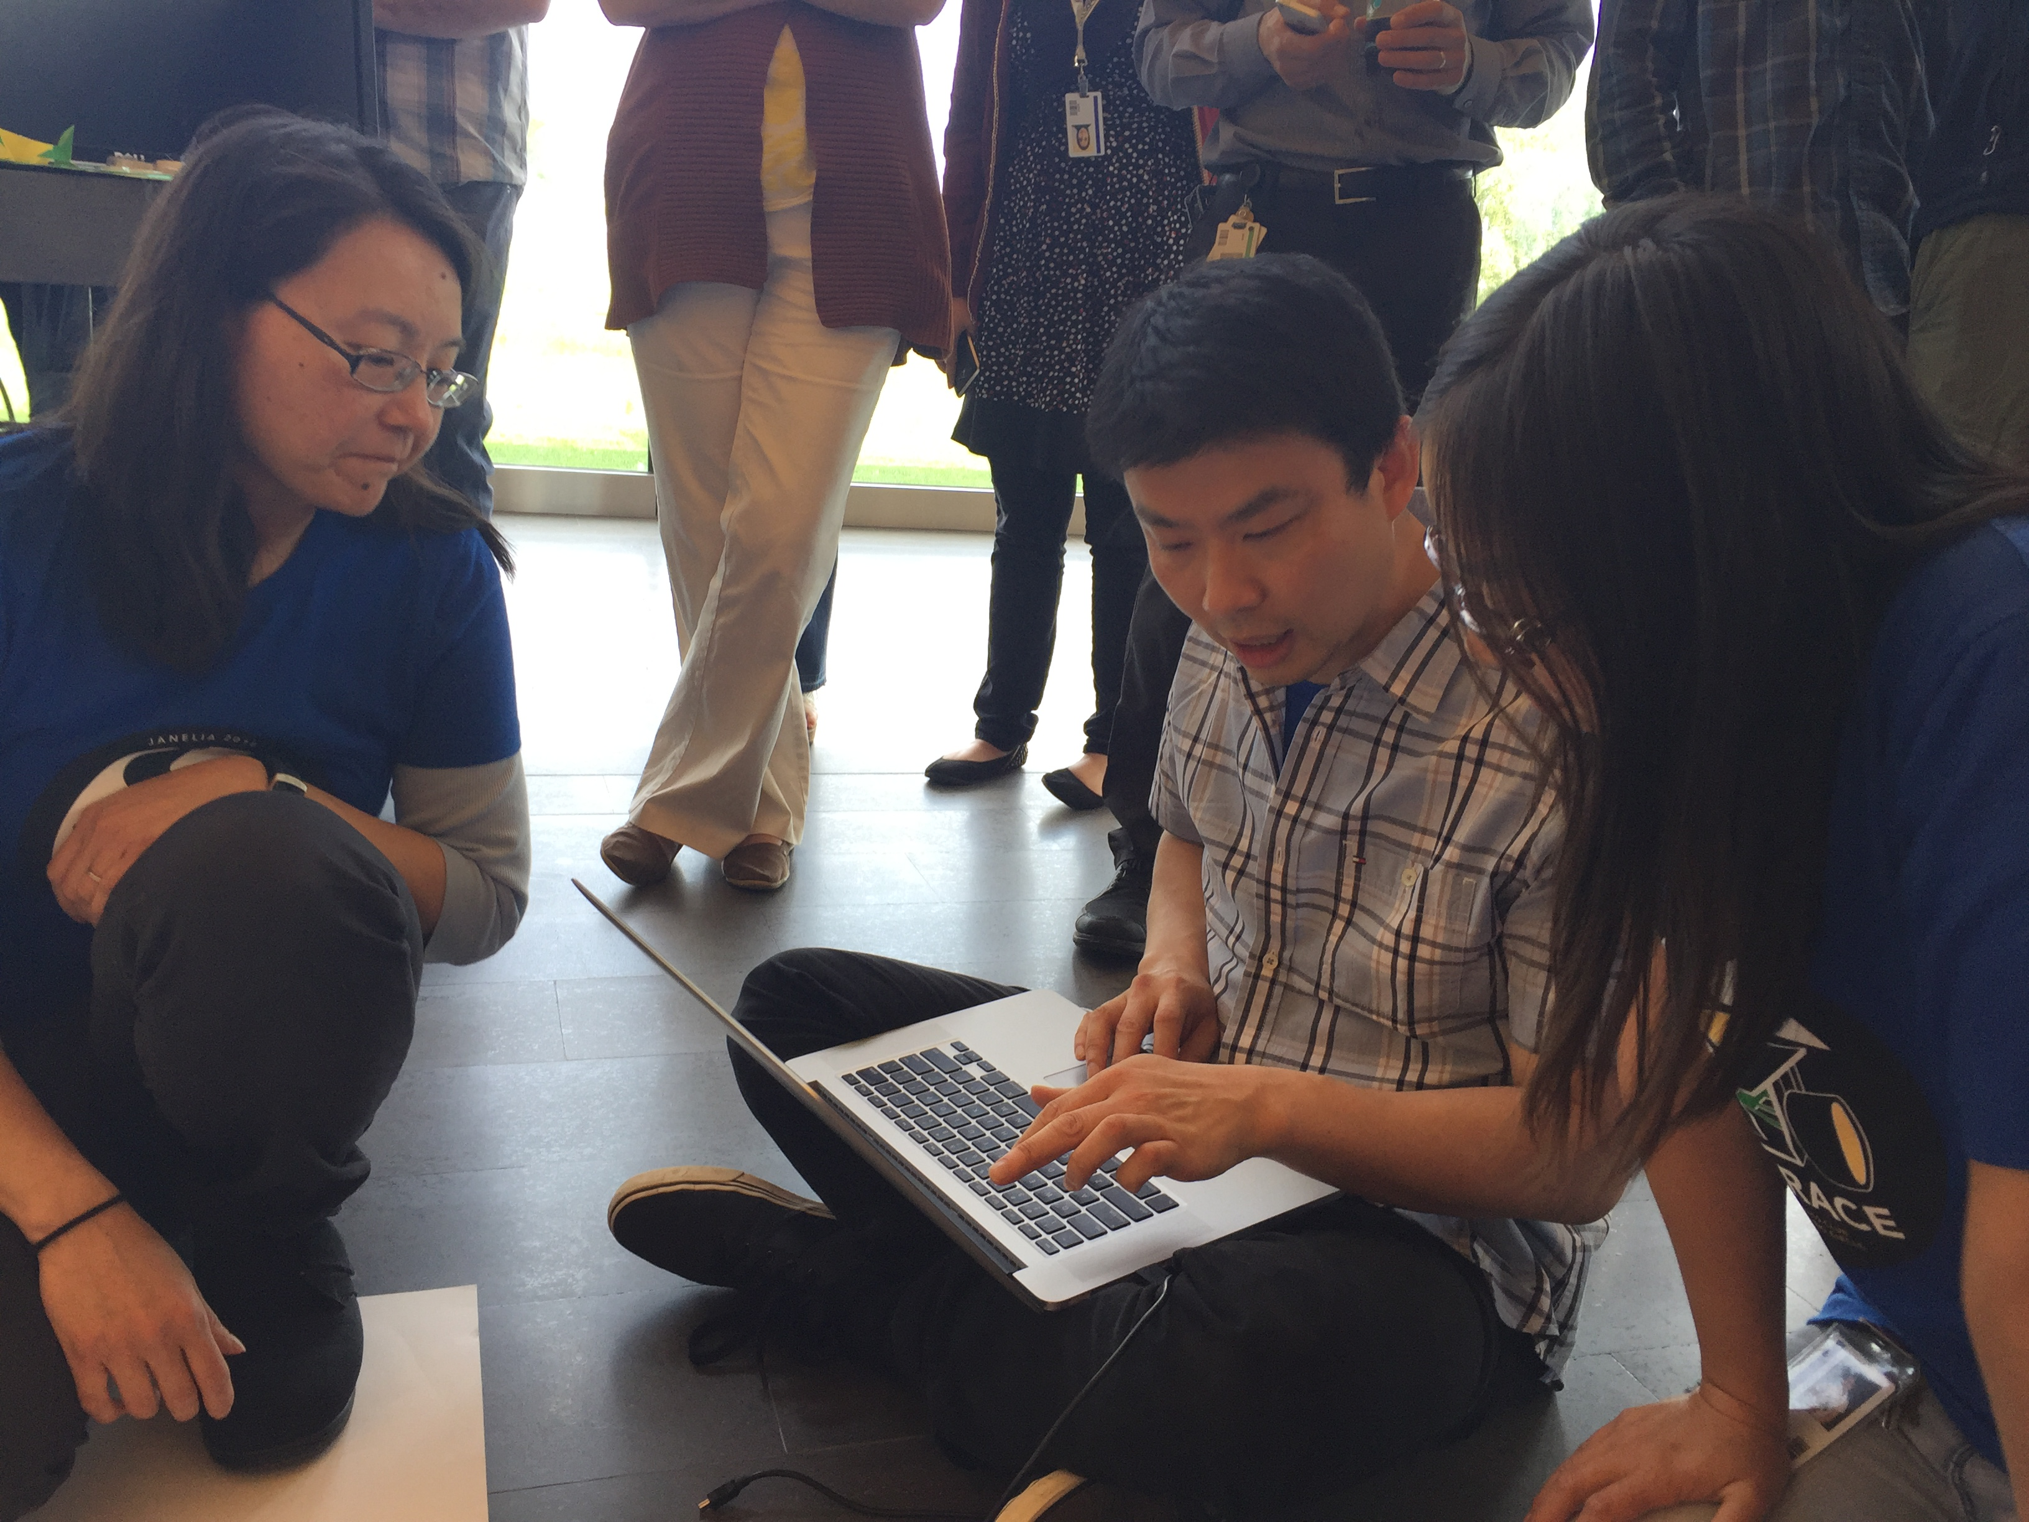
Three Flies and a Guy
Janelia Robot Race 2016
Chen Wang, Jin Liu, Teri Ngo, and Ellie Sterne

Slide 2
Finding the correct target
x
Target is green signature in the center of the road path
Signature is always on bottom of image
Obtained using the get_blocks() function
Target has a maximum height of 50 pixels
Target height is less than width
0
320
Tall green pylon
y
100
Line1minYpos=110
Target
Line1MaxHeight=50
Pixy “sensory field”
200
### tune parameter
Line1MinYpos = 110 ;
Line1MaxHeight = 50 ;
Teri: last update 20160620

Slide 3
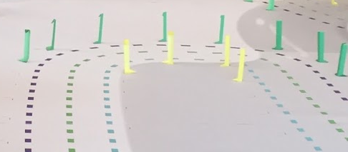
Finding the correct target
def loop():
""" #Jin added explanation
Main loop, Gets blocks from pixy, analyzes target location, chooses action for robot and sends instruction to motors
"""
global blocks, throttle, diffGain, bias, advance, turnError, currentTime, lastTime, objectDist, distError, panError_prev, distError_prev,
turnError_prev
#Jin created global variables below
global Line1MinYPos, Line1MaxWidth, Line1MaxHeight, Line2MinYpos, paneErrorThreshold1, lastLoopTime, diffDrive,
currentTime = datetime.now()
# If no new blocks, don't do anything
while not pixy.pixy_blocks_are_new() and run_flag:
pass
count = pixy.pixy_get_blocks(BLOCK_BUFFER_SIZE, blocks)
# If negative blocks, something went wrong
if count < 0:
print 'Error: pixy_get_blocks() [%d] ' % count
pixy.pixy_error(count)
#sys.exit(1)
# if more than one block
# Check which the largest block's signature and either do target chasing or
# line following
if count > 0: #Teri: Jin's objective: simple code-trained only "green" color marker
lastTime = currentTime
# if Pixy sees a guideline, perform line following algorithm
findBlock1 = 0 #Teri: Jin created boolean variable to find biggest green line block
for index in range(0, count): #Teri: use to find desired signature and remove
if blocks[index].y>Line1MinYPos and blocks[index].height<Line1MaxHeight and blocks[index].height<blocks[index].width:
block1 = blocks[index] #Teri--Jin: to get rid of green tall pylon get size of main signature blocks
findBlock1 = 1
break
1
Teri: last update 20160620

Slide 4
Dynamic regulation of diffDrive
Replace diffGain with diffDrive
Relates diffDrive to panError
Dynamically regulates speed in turns
Tuned with trial and error
if findBlock1 == 1: #Jin: succeed in finding target block
panError = PIXY_X_CENTER - block1.x #Teri: deviation of object we want to follow with camera's ctr
throttle = 1.0 #max power --Jin changed from 0.5 to 1.0
diffDrive = abs(float(panError))/300+0.4
#Teri: diffDrive = power used to drive motor--Chen: by trial & error found 0.4 is ideal, diffDrive = 0.5 if slow turn // diffDrive = 0.8 if sharp turn
panLoop.update(panError)
# Update pixy's pan position
pixy.pixy_rcs_set_position(PIXY_RCS_PAN_CHANNEL, panLoop.m_pos)
# if Pixy sees nothing recognizable, don't move.
time_difference = currentTime - lastTime
if time_difference.total_seconds() >= timeout:
throttle = 0.0
diffDrive = 1
2
Teri: last update 20160620

Slide 5
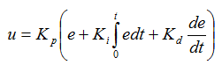
Proportional-Derivative (PD) control
#Jin added next 2 lines: for motor control b/c change p-control to PD control so need to calculate dt
time_difference = currentTime - lastLoopTime
dt = time_difference.total_seconds()
# this is turning to left
if panLoop.m_pos > PIXY_RCS_CENTER_POS:
# should be still int32_t
turnError = panLoop.m_pos - PIXY_RCS_CENTER_POS #Teri: how much need to turn
# <0 is turning left; currently only p-control is implemented
ud = h_dgain * float(turnError - turnError_prev)/dt #Jin added
bias = - float(turnError + ud) / float(PIXY_RCS_CENTER_POS) * h_pgain #Jin added ud to bias eqn
##D control is added to right turn but not shown to conserve space
Calculates error between desired setpoint and process variable and attempts to minimize error over time
Initial code only implements P control for the motor
Doesn’t sync with the camera which is PD controlled
Leads to zigzags in turns asynchrony
Added D control (for PD motor control)
Speeds response time
Increases synchrony between camera and motor
Allows smooth control through turns
3
# body-turning p-gain (was 0.5)
h_pgain = 0.7
# body turning d-gain (was 0)
h_dgain = 0.2
Constants:
K_{p} = h_pgain
K_{d} = h_dgain
Calculating Derivative term (ud) = K_{d}*ΔturnError/Δtime
Bias (u) is the controller output (power to the motor) incorporated by adding ud to the equation
ud
bias
Teri: last update 20160620

